Slide 1
Lecture 04
Directness in positive and neutral situations

Slide 2
Directness in communication
Most business messages use a direct organizational pattern.
That is, the message leads with its most important point and then moves to additional or supporting information.
There are, of course, unlimited kinds of direct messages. Each business is unique in some ways
Still, one can identify a certain basic plan for the direct message.
Moreover, certain situations calling for a direct approach have occurred so often that we can identify several common types of these messages.

Slide 3
General direct plan
Begin by assessing the reader’s probable reaction. A positive or neutral reaction calls for directness; a negative reaction, indirectness.
Begin with your objective. If you are seeking information, start by asking for it. If you are giving information, start giving it.
Whatever your key point is, lead with it.
In some cases, you might need to open with a brief orienting phrase, clause, or even sentence.
Especially if your reader is not expecting to hear from you or is not familiar with you or your company, you may need to preface your main point with a few words of background.

Slide 4
General direct plan
But get to the point as soon as possible. For example, the sentence “We have received your May 7 inquiry” does nothing but state the obvious.
Keep any prefatory remarks brief and get to the real message. Then stop the first paragraph. Let the rest of the message fill in the details.

Slide 5
General direct plan
Cover the remaining part
Whatever else must be covered to complete the objective makes up the bulk of the remainder of the message.
If you cover all of your objective in the beginning (as in an inquiry in which a single question is asked), nothing else is needed.
If additional questions, answers, or information are needed, you cover them systematically—perhaps listing them or arranging them by paragraphs.
If these parts have their own explanations or commentary, you include them.

Slide 6
General direct plan
Ending with goodwill
End this message with some appropriate friendly comment.
General closes as “A prompt reply will be appreciated” and “Thank you for your time and consideration” are positive, for they express a friendly thank-you.
The problem is in the routine, rubber-stamp nature of many of these expressions.
A more positive reaction results from an individually tailored expression that fits the one case—for example: “If you will answer these questions about Ms. Hill right away, she and I will be most grateful.”

Slide 7
General direct plan
Be aware, though, that phrases such as “as soon as possible” or “at your convenience” may have very different meanings for you and your reader.
If you need your response by a specific date or time, give your reader that information as well as a reason for the deadline so that your reader understands the importance of a timely response.
You may say, for example, “Your answers to these questions by July 1 will help Ms. Hill and us as we meet our deadline for filling the accounting position.”

Slide 8
Routine inquiries

Slide 9
Routine inquiries
Assume you are the assistant to the vice president for administration of Pinnacle Manufacturing Company.
At the moment, your boss is working with a group of Pinnacle executives to select offices for a new regional headquarters. Of course, your boss has delegated much of the work to you.
You have found three possible office suites in the chosen city. The first of these you found in the classified advertisements of the local newspaper.
It is a 3,200-square-foot office suite, but the ad tells little more. So now you must write the advertiser a routine inquiry seeking the information the management team needs.

Slide 10
Routine inquiries
Here is how to write appropriate for situations like this -
Routine inquiries appropriately begin by asking either of two types of questions:
(1) A specific question that sets up the information wanted. Ex -
Can you please send me additional information about the floor plan of the office suite that you advertised in Monday’s Sentinel Times ?
(2) A general request for information. Ex -
Will you please send me a description of the features of the 3,200-square-foot office suite advertised in Monday’s Daily Journal ?

Slide 11
Routine inquiries
To help your reader answer your questions, you may need to include explanation or information. If you do not explain enough or if you misjudge the reader’s knowledge, you make the reader’s task difficult.
For example, answers to your questions about office space for Pinnacle Manufacturing may depend on characteristics or specific needs of the company.
Without knowing how Pinnacle Manufacturing will use the space, even the best realtor or property manager may not know how to answer your questions or perhaps direct you to other office space that better meets your needs.

Slide 12
Routine inquiries
If your inquiry involves more than one question, make each stand out. Do this by -
(1) Placing each question in a separate sentence
Make each question a separate sentence with a bullet (for example, ●, 􀀁, ■) to call attention to it.
Combining two or more questions in a sentence de-emphasizes each and invites the reader to overlook some.
(2) Structuring the questions in separate paragraphs

Slide 13
Routine inquiries
(3) Ordering or ranking the questions.
By using words ( first, second, third, etc.), numerals (1, 2, 3, etc.), or letters ( a, b, c, etc.), you make the questions stand out.
Also, you provide the reader with a convenient checklist for answering.
(4) Using the question form of sentence
Expressions like “It would be nice if you would tell me . . .” and “I would like to know . . .” are really not questions. They do not ask—they merely suggest. The questions that stand out are those written in question form: “Will you please tell me . . . ?” “How much would one be able to save . . . ?” “How many contract problems have you had . . . ?”

Slide 14
Routine inquiries
Take care when asking questions that produce yes or no answers.
Avoid questions that can be answered with a simple yes or no unless you really want a simple yes or no answer.
For example, the question “Is the chair available in blue?” may not be what you really want to know.
Better wording might be “In what colors is the chair available?”

Slide 15
Routine inquiries
Ending with goodwill
The goodwill ending described in the general plan is appropriate here, just as it is in most business messages.
And we must emphasize again that the closing words do the most toward creating goodwill when they fit the one case.
Remember to include important deadlines and reasons for them as well.

Slide 16
Routine inquiries
So in summary -
Focus directly on the objective, with either a specific question that sets up the entire message or a general request for information.
Include necessary explanation—wherever it fits.
If a number of questions are involved, make them stand out with bullets, numbering, paragraphing, and question form.
End with goodwill words adapted to the individual case.
Checkout lecture 4 supporting examples for more examples.

Slide 17
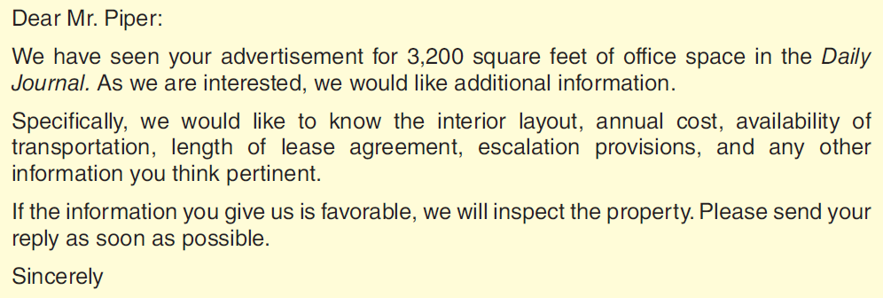
Routine inquiries
Example - Here is a sample response to the scenario described earlier. What is wrong with this response?

Slide 18
Routine inquiries
The less effective message begins slowly and gives obvious information. Even if the writer thinks that this information needs to be communicated, it does not deserve the emphasis of the opening sentence. The
Writer gets to the point of the message in the second paragraph. But there are no questions here—just hints for information. The items of information the writer wants do not stand out but are listed in rapid succession in one sentence.
The close is selfish and stiff.

Slide 19
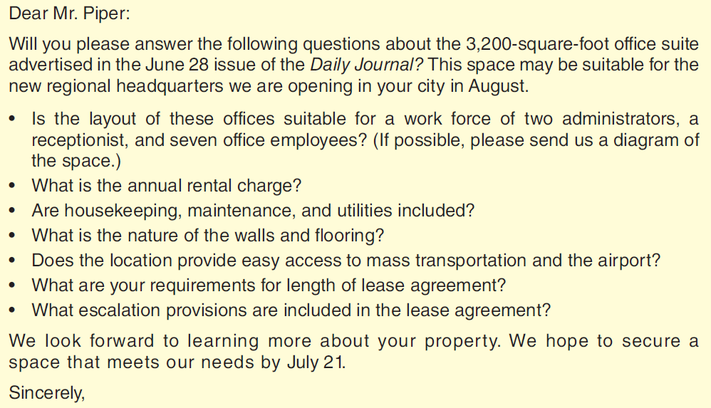
Routine inquiries
An effective example -

Slide 20
Routine inquiries
An effective example -
Can you say why this sample is better?

Slide 21
Favourable responses

Slide 22
Favourable responses
When responding to inquiries favorably, you should begin directly.
If the response contains only one answer, begin with it.
Ex - Yes, you can use Chem-Treat to prevent mildew.
If it contains more than one answer, begin with a major one or a general statement indicating you are answering.
The following information should tell you what you need to know about Chem-Treat.
Here are the answers to your questions about Chem-Treat.
Identify the message being answered early, perhaps in a subject line.

Slide 23
Favourable responses
When responding to inquiries favorably, you should begin directly.
Arrange your answers (if more than one) logically.
And make them stand out.
If both good- and bad-news answers are involved, give each answer the emphasis it deserves, perhaps by subordinating the negative.
Place favorable responses at beginnings and ends. Give them more space. Use words skillfully to emphasize them.

Slide 24
Favourable responses
For extra goodwill effect, consider doing more than was asked -
To create goodwill, as well as future business, you should consider including extras with your answers. These are the things you say and do that are not actually required.
Examples are a comment or question showing an interest in the reader’s problem, some additional information that may prove valuable, and a suggestion for use of the information supplied.
Illustrations of how extras can be used to strengthen the goodwill effects of a message are as broad as the imagination.

Slide 25
Favourable responses
A business executive answering a college professor’s request for information on company operations could supplement the requested information with suggestions of other sources.
A technical writer could amplify highly technical answers with simpler explanations.
Such extras encourage readers to take the extra step in building a business relationship with you.

Slide 26
Favourable responses
When responding to inquiries favorably (continued)
End with appropriate cordiality - As in the other direct messages, your ending should be cordial, friendly words that fit the one case.
For example: If I can help you further in deciding whether Chem-Treat will meet your needs, please email me again.

Slide 27
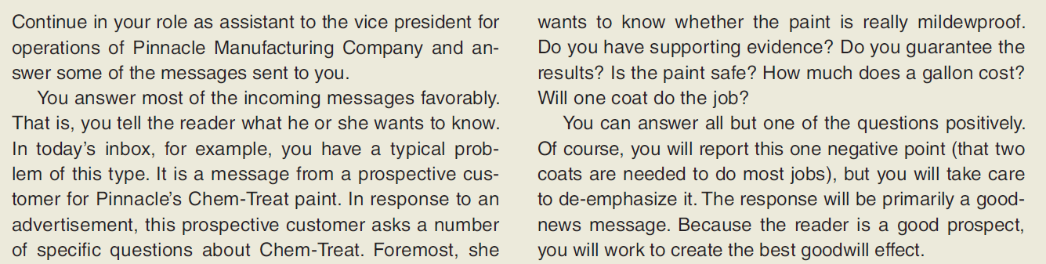
Favourable responses
Let’s consider the scenario -

Slide 28
Favourable responses
(Continued) -

Slide 29
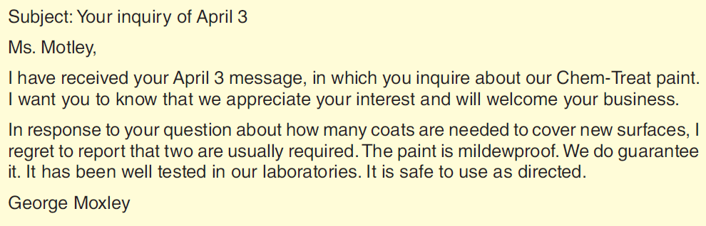
Favourable responses
Contrasting examples - Is the following answer good or bad? Why?

Slide 30
Favourable responses
The previous message begins indirectly with an obvious statement referring to receipt of the inquiry.
Though well intended, the second sentence continues to delay the answers.
The second paragraph begins to respond to the reader’s request, but it emphasizes the most negative answer by position and by wording.
This answer is followed by hurried and routine answers to the other questions asked. Only the barest information is presented. There is no goodwill close.

Slide 31
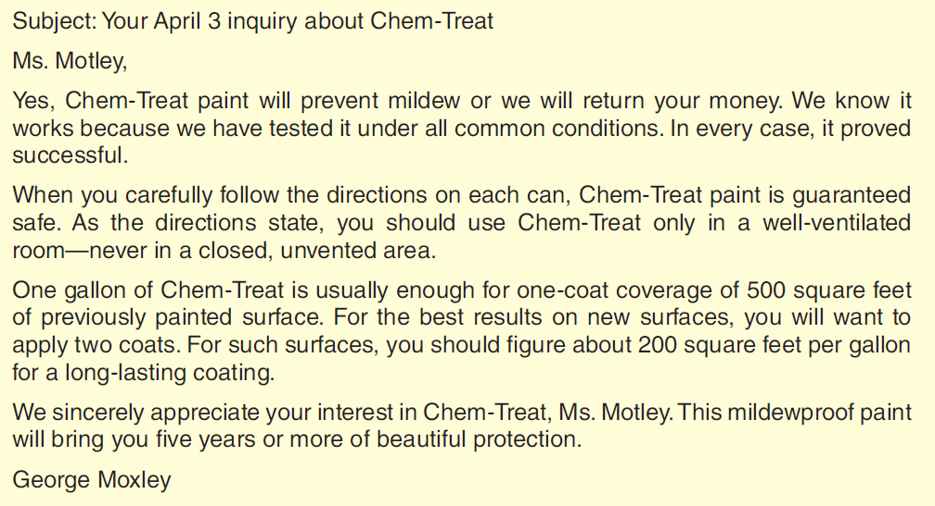
Favourable responses
Contrasting examples - Is the following answer good or bad? Why?

Slide 32
Favourable responses
Contrasting examples - Is the following answer good or bad? Why?

Slide 33
Favourable responses
The better message begins directly with the most favorable answer.
Then it presents the other answers, giving each the emphasis and positive language it deserves.
It subordinates the one negative answer by position, volume of treatment, and structure. More pleasant information follows the negative answer.
The close is goodwill talk with some subtle selling strategy thrown in. “We know that you’ll enjoy the long-lasting beauty of this mildewproof paint” points positively to purchase and successful use of the product.
Checkout lecture 4 supporting examples for more examples.

Slide 34
Adjustment grants

Slide 35
Adjustment grants
When you can grant an adjustment, the situation is a happy one for your customer. You are correcting an error. You are doing what you were asked to do. As in other positive situations, a message written in the direct order is appropriate.
But they differ from other direct-order messages in that they involve a negative situation.
Something has gone wrong.
You are correcting that wrong.
But you also should overcome the negative image in the reader’s mind.

Slide 36
Adjustment grants
You do this by first telling the good news—what you are doing to correct the wrong.
Ex - The enclosed check for $89.77 is our way of proving to you that we value your satisfaction highly.
In the opening and throughout, emphasize the positive.
Avoid the negative—words like trouble, damage, and broken.
Negative language makes the customer’s complaint the focus of your message.
Your goal is to move the customer beyond the problem and to the solution

Slide 37
Adjustment grants
Also negative are the apologies often included in these messages.
Even though well intended, the somewhat conventional “we sincerely regret the inconvenience . . .” type of comment is of questionable value.
It emphasizes the negative happenings for which the apology is made.
If you sincerely believe that you owe an apology or that one is expected, you can apologize and risk the negative effect. But do it early and move on, and don’t repeat it at the end.
In most instances, however, your efforts to correct the problem will show adequate concern for your reader’s interests.

Slide 38
Adjustment grants
Try to regain the reader’s lost confidence, maybe with an explanation or with assurance of corrective measures taken.
End with a goodwill comment, avoiding words that recall what went wrong.

Slide 39
Adjustment grants
So in summary -
Begin directly—with the good news.
Incidentally identify the correspondence that you are answering.
Avoid negatives that recall the problem.
Regain lost confidence through explanation or corrective action.
End with a friendly, positive comment.

Slide 40
Adjustment grants
Contrasting examples - Consider the following scenario
Continuing in your role with Pinnacle, this time you find on your computer an email message from an unhappy customer.
It seems that Ms. Bernice Watson, owner of Tri-Cities Hardware, is upset because some of the 30 Old London lamp posts she ordered from Pinnacle arrived in damaged condition.
“The glass is broken in 17 of the units,” she writes, “obviously because of poor packing.”
She had ordered the lights for a special sale.

Slide 41
Adjustment grants
(continued)
In fact, she notes, she had even featured them in her advertising.
The sale begins next Friday. She wants a fast adjustment—either the lamps by sale time or her money back.
Of course, you will grant Ms. Watson’s request. You will send her an email message saying that the goods are on the way.
And because you want to keep this good customer, you will try to regain any lost confidence with an honest explanation of the problem.
This message is classified as an adjustment grant.

Slide 42
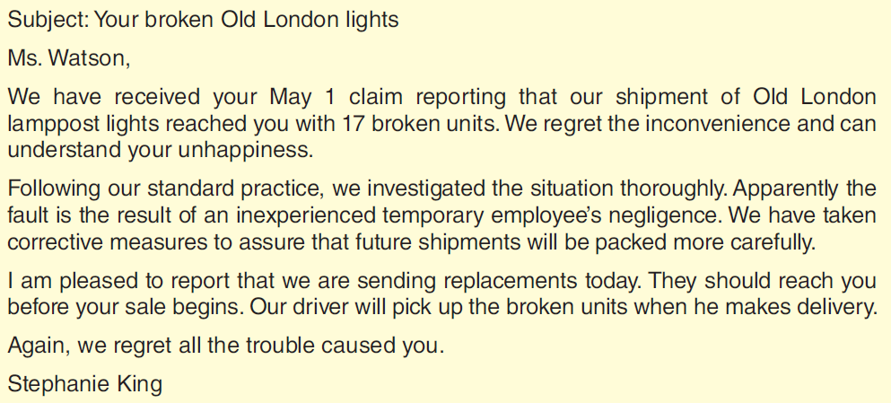
Adjustment grants
Contrasting examples - Slow and negative approach

Slide 43
Adjustment grants
The ineffective message begins with an obvious comment about receiving the claim.
It recalls vividly what went wrong and then painfully explains what happened.
As a result, the good news is delayed for an additional paragraph.
Finally, after two delaying paragraphs, the message gets to the good news.
Though well intended, the close leaves the reader with a reminder of the trouble.

Slide 44
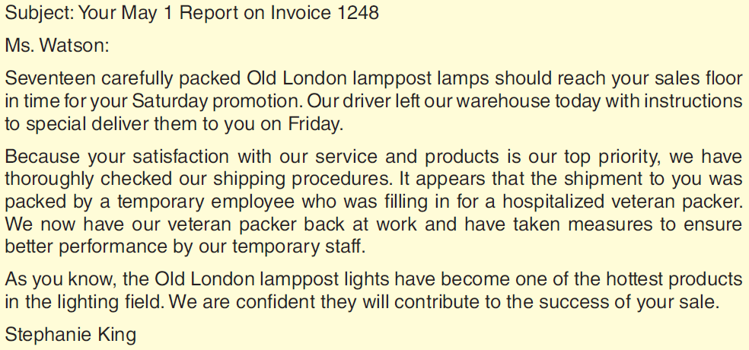
Adjustment grants
Contrasting examples - Direct and effective approach

Slide 45
Adjustment grants
The better message uses the subject line to identify the transaction.
The opening words tell the reader what she most wants to hear in a positive way that adds to the goodwill tone of the message.
With you-viewpoint explanation, the message then reviews what happened.
Without a single negative word, it makes clear what caused the problem and what has been done to prevent its recurrence.
After handling the essential matter of picking up the broken lamps, the message closes with positive talk removed from the problem.
Checkout lecture 4 supporting examples for more examples.

Slide 46
Thank you messages

Slide 47
Thank you messages
Write order acknowledgments and other thank-you messages in the form of a favorable response.
Let’s take the example of order confirmation, a very common case requiring acknowledgement or thank you message.
Like the preceding direct message types, the acknowledgment message appropriately begins with its good news—that the goods are being shipped. Ex - The Protect-O paints and supplies you ordered April 4 should reach you by Wednesday. They are leaving our Walden warehouse today by Arrow Freight.
It can also include a warm expression of thanks for the order, especially when a first order is involved

Slide 48
Thank you messages
When goods must be delayed, handle this news tactfully.
You can do this by using positive language that focuses on what can or will happen rather than what didn’t or won’t happen.
For example, in vague orders, request the needed information positively.
To illustrate, you gain nothing by writing “You failed to specify the color of phones you want.”
But you gain goodwill by writing “So that we can send you precisely the phones you want, please check your choice of colors on the space below.”

Slide 49
Thank you messages
Similarly, you can handle back-order information tactfully by emphasizing the positive part of the message.
For example, instead of writing “We can’t ship the ink jet cartridges until the 9th,” you can write “We will rush the ink jet cartridges to you as soon as our stock is replenished by a shipment due May 9.”
If the back-order period is longer than the customer expects or longer than the 30 days allowed by law, you may choose to give your customer an alternative.
You could offer a substitute product or service. Giving the customer a choice builds goodwill.

Slide 50
Thank you messages
Consider the following scenario -
The next work you take from your inbox is an order for paints and painting supplies. It is from Mr. Tony Lee of the Central City Paint Company, a new customer whom Pinnacle has been trying to attract for months.
You usually acknowledge orders with routine messages, but this case is different. You feel the need to welcome this new customer and to cultivate him for future sales.
After checking your current inventory and making certain that the goods will be on the way to Lee today, you are ready to write him a special acknowledgment and thank him for his business.

Slide 51
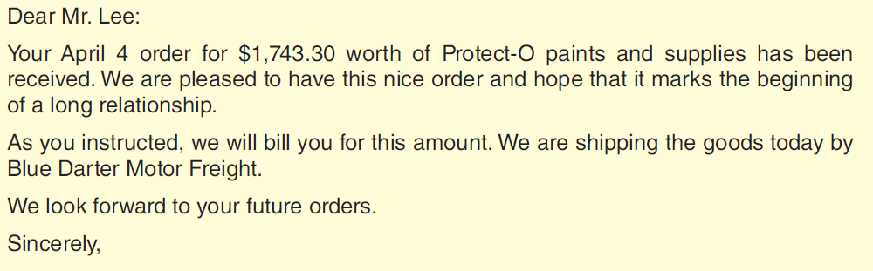
Thank you messages

Slide 52
Thank you messages
The bad example begins indirectly, emphasizing receipt of the order.
Although intended to produce goodwill, the second sentence further delays what the reader wants most to hear.
Moreover, the letter is written from the writer’s point of view (note the we-emphasis).

Slide 53
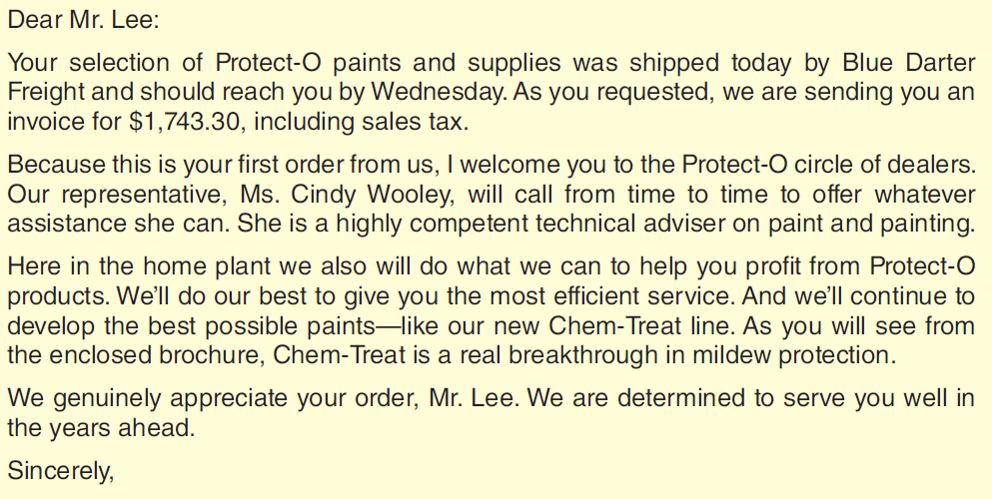
Thank you messages

Slide 54
Thank you messages
The better message begins directly, telling Mr. Lee that he is getting what he wants.
The remainder of the message is a customer welcome and subtle selling.
Notice the good use of reader emphasis and positive language.
The message closes with a note of appreciation and a friendly, forward look.
Checkout lecture 4 supporting examples for more examples.

Slide 55
Operational communication

Slide 56
Operational communication
Operational (internal) communications must also be clear and effective. The following instructions explain how to write operational communications:
Organize most of them in the direct order.
Write the casual ones as you would write good conversations.
Make them clear and courteous.
Give administrative communications (policies, directives, procedures) the careful attention they deserve.
Organize them logically; strive for clarity.

Slide 57
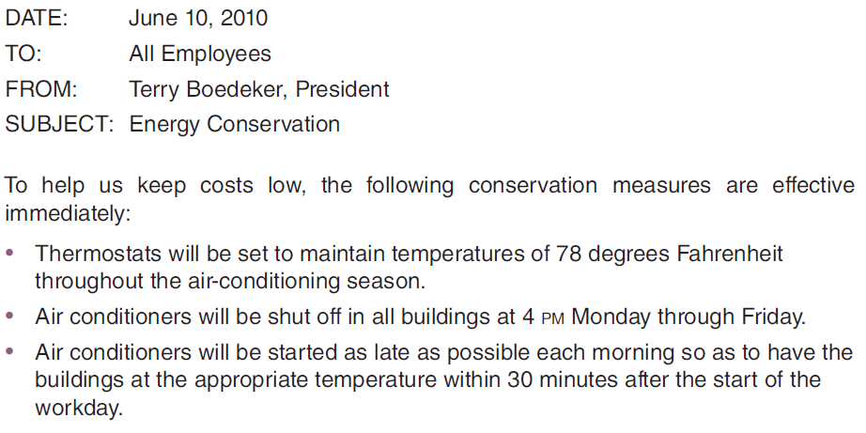
Operational communication
Let’s have a look at a sample memo -

Slide 58
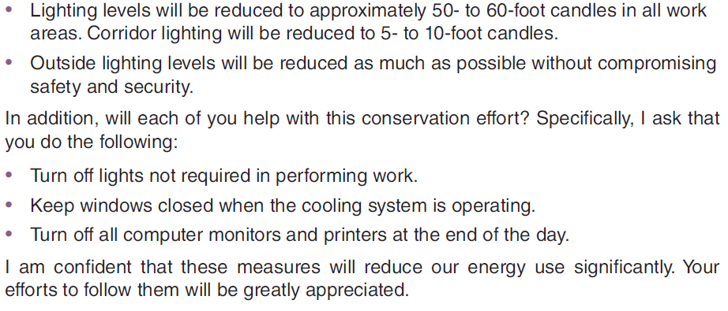
Operational communication
(Continued) -

Slide 59
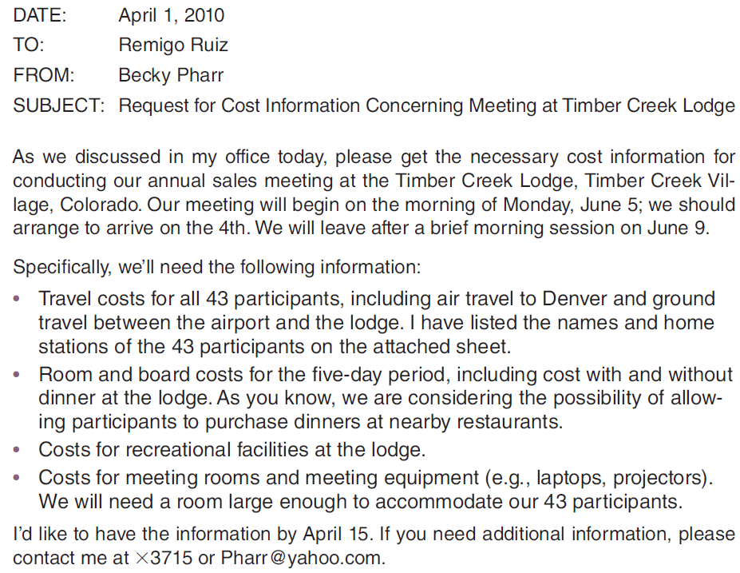
Operational communication
Another example -

Slide 60
Operational communication
(continued) -
Checkout lecture 4 supporting examples for more examples.

Slide 61
Discussion & Debate

Slide 62
Discussion & Debate
1. When is the direct order appropriate in inquiries? When would you use the indirect order? Give examples.
2. “Explanations in inquiries merely add length and should be eliminated.” Discuss.
3. Discuss why just reporting truthfully may not be enough in handling negative information in messages answering inquiries.
4. Defend a policy of doing more than asked in answering routine inquiries. Can the policy be carried too far?
5. What can acknowledgment messages do to build goodwill?

Slide 63
Discussion & Debate
6. Discuss situations where each of the following forms of an order acknowledgment would be preferred: form letter, merged letter, and a special letter.
7. Discuss how problems (vague orders, back orders) should be handled in messages acknowledging orders.
8. Why is it usually advisable to do more than just grant the claim in an adjustment-grant message?
9. Discuss the use of directness in operational communications. Why is it desirable? Can it be overdone? When might indirectness be appropriate?

Slide 64
Exercises

Slide 65
Exercises - Q1
Point out the shortcomings in this email response to an inquiry about a short course in business communication taught by a professor for the company’s employees.
The inquiry included five questions:
(1) How did the professor perform?
(2) What was the course format (length, meeting structure)?
(3) What was the employee evaluation of the instruction?
(4) Was the course adapted to the company and its technical employees?
(5) Was homework assigned?

Slide 66
Exercises - Q1
Subject: Course evaluation
Mr. Braden:
Your January 17 inquiry addressed to the Training Director has been referred to me for attention since we have no one with that title. I do have some training responsibilities and was the one who organized the in-house course in clear writing. You asked five questions about our course.
Concerning your question about the instructor, Professor Alonzo Britt, I can report that he did an acceptable job in the classroom. Some of the students, including this writer, felt that the emphasis was too much on grammar and punctuation, however. He did assign homework, but it was not excessive.

Slide 67
Exercises - Q1
We had class two hours a day from 3:00 to 5:00 PM every Thursday for eight weeks. Usually the professor lectured the first hour. He is a good lecturer but sometimes talks over the heads of the students. This was the main complaint in the evaluations the students made at the end of the course, but they had many good comments to make also. Some did not like the content, which they said was not adapted to the needs of a technical worker. Overall, the professor got a rating of B– on a scale of A to F.
We think the course was good, but it could have been better adapted to our needs and our people. I also think it was too long—about 10 hours (five meetings) would have been enough. Also, we think the professor

Slide 68
Exercises - Q1
spent too much time lecturing and not enough on application work in class.
Please be informed that the information about Professor Britt must be held in confidence.
Casey Webster

Slide 69
Exercises - Q2
Point out the shortcomings in this message granting a claim for a fax machine received in damaged condition. Inspection of the package revealed that the damage did not occur in transit.
Dear Ms. Orsag: Your May 3 letter in which you claim that the Rigo FAX391 was received in damaged condition has been carefully considered. We inspect all our machines carefully before packing them, and we pack them carefully in strong boxes with Styrofoam supports that hold them snugly. Thus we cannot understand how the damage could have occurred.

Slide 70
Exercises - Q2
Even so, we stand behind our product and will replace any that are damaged. However, we must ask that first you send us the defective one so we can inspect it. After your claim of damage has been verified, we will send you a new one.
We regret any inconvenience this situation may have caused you and assure you that problems like this rarely occur in our shipping department.
Scott Hilderbran

Slide 71
Exercises - Q3
List your criticisms of this email message inquiring about a convenience store advertised for sale:
Subject: Store details needed
Mr. Meeks:
This is in response to your advertisement in the May 17 Daily Bulletin in which you describe a convenience store in Clark City that you want to sell. I am very much interested since I would like to relocate in that area. Before I drive down to see the property, I need some preliminary information. Most important is the question of financing. I am wondering whether you would be willing to finance up to $50,000 of the total if I

Slide 72
Exercises - Q3
could come up with the rest, and how much interest you would charge and for how long. I also would like to have the figures for your operations for the past two or three years, including gross sales, expenses, and profits. I also need to know the condition of the building, including such information as when built, improvements made, repairs needed, and so on.
Hoping that you can get these answers to me soon so we can do business.

Slide 73
Exercises - Q4
Criticize the following thank-you message from a college student to a professor who has sent her a job lead.
Subject: Thanks
Dear Prof. Smith,
Thanks for the hot tip on the job! I’m interviewing there tomorrow!
Sarah

Slide 74
Exercises - Q5
Criticize the following operational message from a hotel manager:
Housekeeping staff,
It has come to my attention that the cleanliness of our rooms is substandard. We will therefore hold mandatory training sessions over the next three weeks. See your shift supervisor to plan your work schedule so that you can attend.
Management

Slide 75
Thank you

